Slide 1
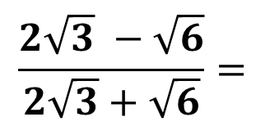
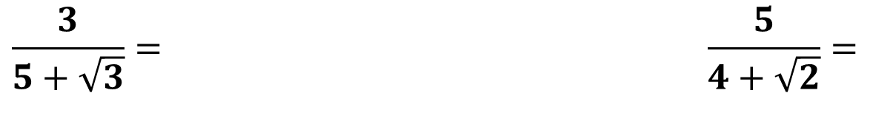
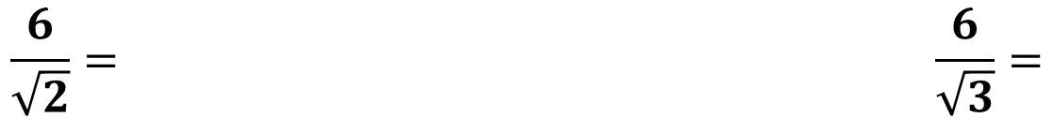
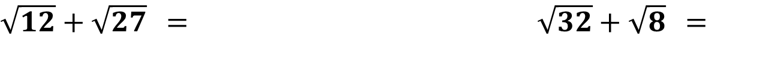
odmocniny 2
A: B:
Zjednoduš:
${\sqrt{12}+\sqrt{27}}^{ }=$ ${\sqrt{32}+\sqrt{8}}^{ }=$
$${(3+\sqrt{5})}^{2 }= {(5+\sqrt{3})}^{2 }=$$
Usmerni:
$$\frac{6}{\sqrt{2}}= \frac{6}{\sqrt{3}}=$$
$$\frac{3}{5+\sqrt{3}}= \frac{5}{4+\sqrt{2}}=$$
$$\frac{2\sqrt{3} −\sqrt{6}}{2\sqrt{3}+\sqrt{6}}=$$
Bonus:

Slide 2
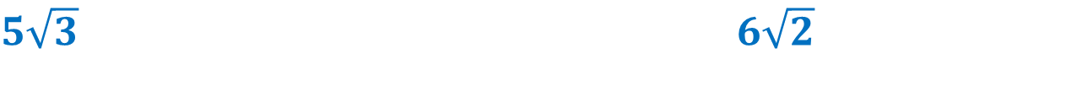
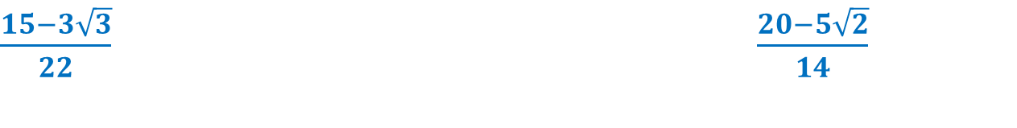

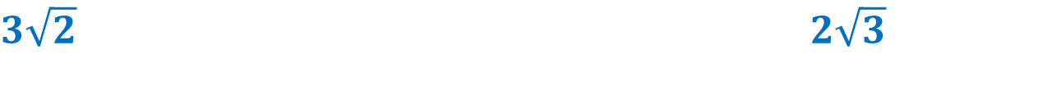
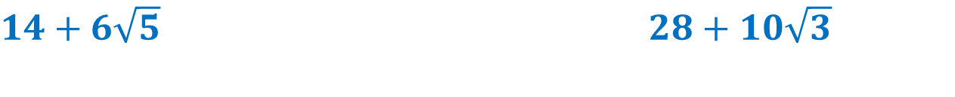
riešenie
A: B:
Zjednoduš:
${5\sqrt{3}}^{ }$ ${6\sqrt{2}}^{ }$
${\sqrt{12}+\sqrt{27}}^{ }=$ ${\sqrt{32}+\sqrt{8}}^{ }=$
${14+6\sqrt{5}}^{ }$ ${28+10\sqrt{3}}^{ }$
$${(3+\sqrt{5})}^{2 }= {(5+\sqrt{3})}^{2 }=$$
Usmerni:
$$\frac{6}{\sqrt{2}}= \frac{6}{\sqrt{3}}=$$
${3\sqrt{2}}^{ }$ ${2\sqrt{3}}^{ }$
$$\frac{3}{5+\sqrt{3}}= \frac{5}{4+\sqrt{2}}=$$
${\frac{15−3\sqrt{3}}{22}}^{ }$ ${\frac{20−5\sqrt{2}}{14}}^{ }$
$$\frac{2\sqrt{3} −\sqrt{6}}{2\sqrt{3}+\sqrt{6}}=$$
Bonus:
$${3−2\sqrt{2}}^{ }$$

